Slide 1
Supervised Learning
By Muhammad Arslan Shahzad @IcodeGuru

Slide 2
Supervised Learning
It is defined by its use of labeled datasets to train algorithms that to classify data or predict outcomes accurately.
Supervised Learning is when we teach the machine using data that is well labelled which means data is already tagged with the correct answers.

Slide 3
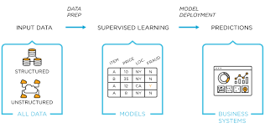
Supervised ML

Slide 4
How it works ?
Supervised Learning uses a training set to teach the model to predict the desired output.
The training data contains the inputs and correct output both.
And this allow the model to learn over time.
Accuracy measures through the loss function, and adjusting errors till best accuracy.

Slide 5
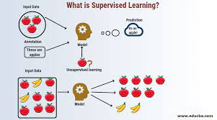
Working of Supervised Learning

Slide 6
Types of Supervised ML
Classification
Regression

Slide 7
Algorithms
Linear Regression
Logistic Regression
Naïve Byes Classifier
SVM
KNN
Random Forest
Neural Networks

Slide 8

Challenges

Slide 9
Challenges of Supervised Learning
Supervised Learning model required a certain level of expertise to structure accurately
Supervised learning models are time intensive
Dataset can have a higher likelihood of human error which results in poor accuracy
It can’t cluster or classify data own its own.

Slide 10
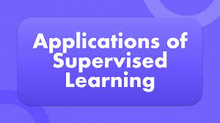

Slide 11
Application of Supervised Learning
Image and Object Detection
Predictive Analysis
Customer Sentiment Analysis
Spam Detection
Time Series (forecasting)

